Slide 1



Chapter: 4
C Programs with Mustafa Rahman
Web & Software Developer
C360Soft.Ai, India. (Remote Job)
ICT Lecturer of MIFM

Slide 2
Loop Control Instructions
To repeat some parts of the program
Types
for do while
while

Slide 3
for Loop
for(initialisation; condition; updation) {
//do something
}

Slide 4
Special Things
- Increment Operator
- Decrement Operator
- Loop counter can be float
or even character
- Infinite Loop

Slide 5
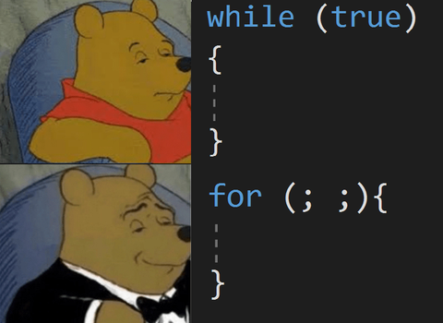
while Loop
while(condition) {
//do something
}

Slide 6
do while Loop
do {
//do something
} while(condition);

Slide 7
break Statement
exit the loop

Slide 8
continue Statement
skip to next iteration

Slide 9
Nested Loops
for( .. ) {
for( .. ) {
}
}

